Slide 1
What Makes A Performer?
Ms. Gomez
Performing Arts
Period 6 & 7

Slide 2
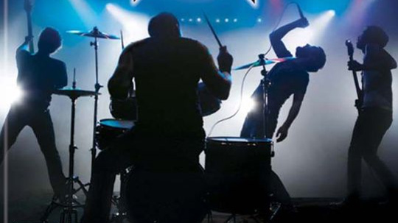
Types of Performers
Musicians
Dancers
Actors
Comedians

Slide 3
Performance Videos
Heath Ledger, “The Joker”
Walk Off The Earth “Royals”
Bill Cosby, “Kid on A Plane”
Jasmine H and Twitch perform in the Top 8, “SYTYCD”

Slide 4
What Makes A Performer?
Courage
Confidence
Takes Risks
Prepared
Commanding

