Slide 1
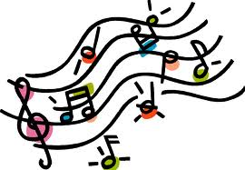
Note Values and Recognition
Ms. Gomez
6th Grade Musicology

Slide 2
WHOLE NOTE
= 4 Beats

Slide 3
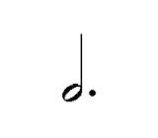
DOTTED HALF NOTE
= 3 Beats

Slide 4
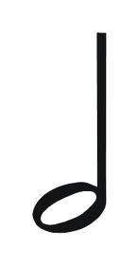
HALF NOTE
= 2 Beats

Slide 5
QUARTER NOTE
= 1 Beat

Slide 6
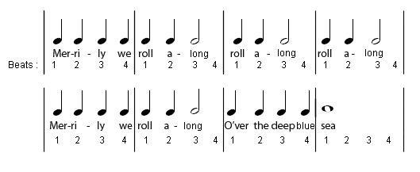
EXAMPLE #1

Slide 7
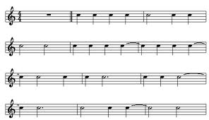
EXAMPLE #2
Line 1
Line 2
Line 3
Line 4

