Slide 1
Expressive Devices
Ms. Gomez
6th Grade Musicology

Slide 2
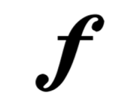
The Loud Guys
Forte=LOUD
Mezzo Forte=Medium Loud
Crescendo=Gradually Louder

Slide 3
The Quiet Guys
Piano=soft
Mezzo Piano=medium soft
Diminuendo=gradually softer

Slide 4
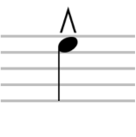
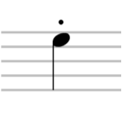
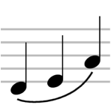
Can Be Loud OR Soft
Accent=Emphasize this note →
Staccato=Choppy, detached notes ---------→
Legato=Smooth, connected notes →

Slide 5
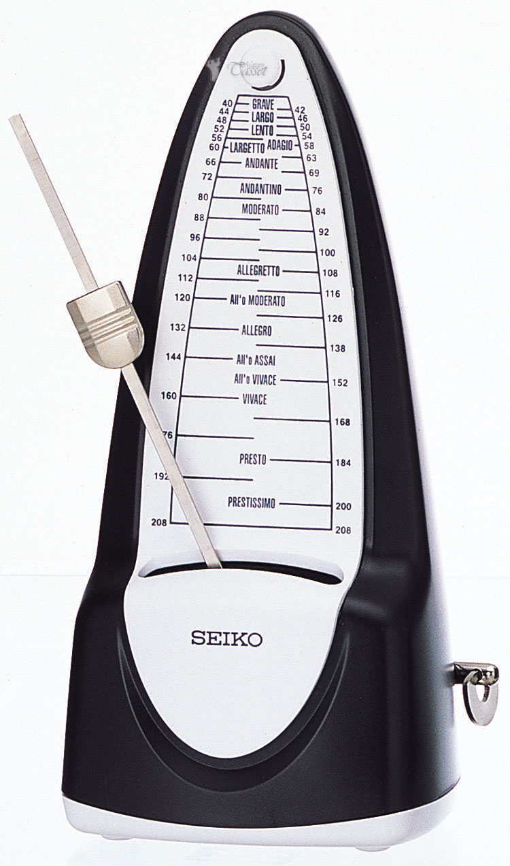
Tempos
Tempos tell us how FAST or SLOW to perform
In order from slowest to fastest:
Grave: Very slow
Adagio: Sauntering, not entirely slow
Andante: Walking tempo
Allegro: Quickly, Cheerful
Vivace: Very fast

